Slide 1
HackIT prototype
DAF Maintenance Prediction
Group 1 - Alex, Angel, Atanas, Stoyan, Tsanko

Slide 2
Content
Our Client
Current Situation
What is Grafana?
Problem Statement
Project goal
What is next?

Slide 3
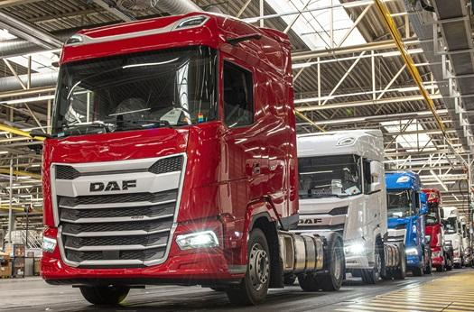
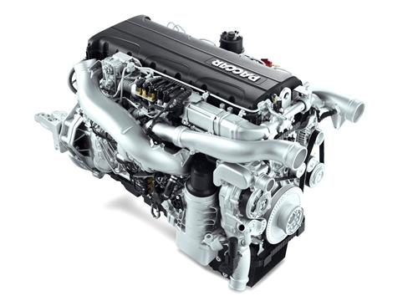
Our Client
DAF
Engine Manufacturing department

Slide 4
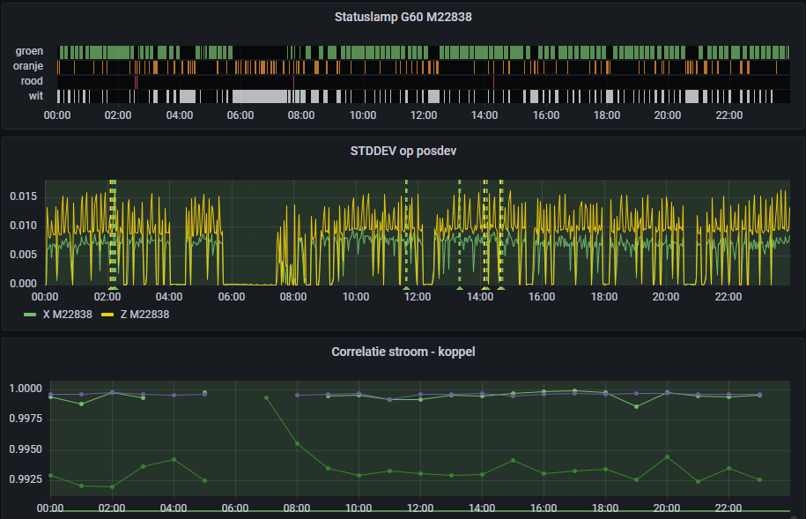
Current Situation
Data is gathered from several machines in the engine factory
The purpose is to give insights into preventative maintenance
Monitor various aspects(temperature, current..)
Detect anomalies before components fail

Slide 5
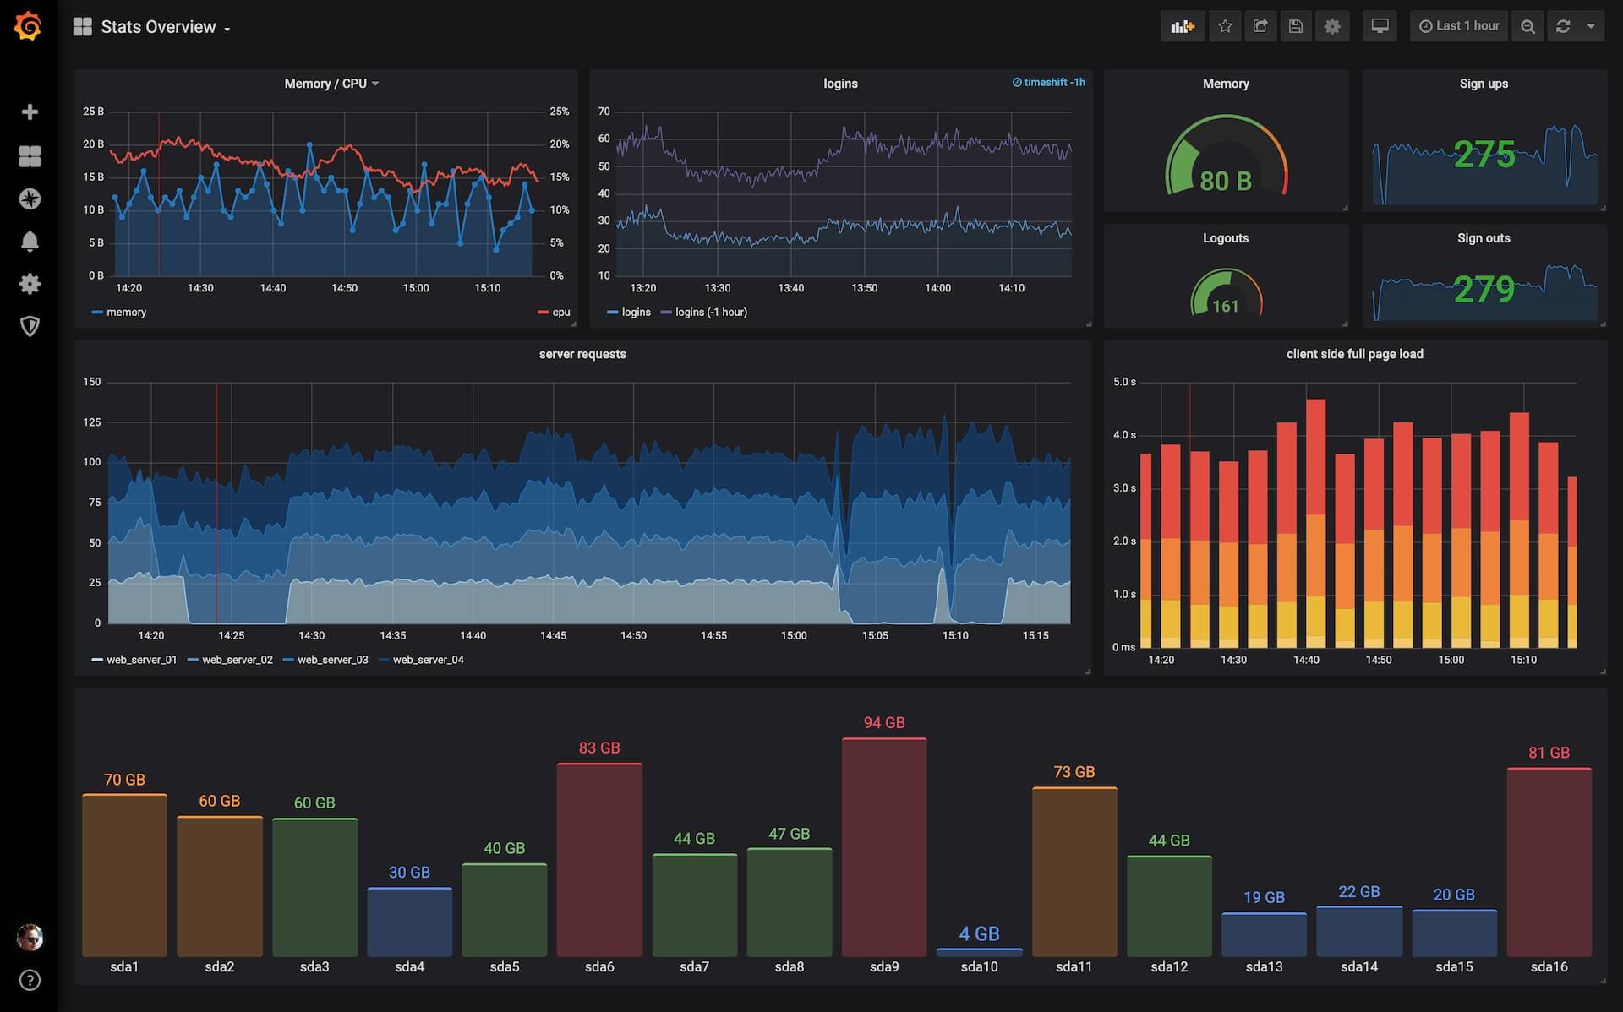
What is Grafana?
Open source analytics & monitoring solution for every database.
Interactive data-visualization platform

Slide 6

Problem statement
No data acquisition on most of the machines in the factory
No general solution with customization for each separate machine.
Improve the alerting system

Slide 7

Project goal
Facilitate insights for condition-based, or preventive maintenance
Start data acquisition on new machines in the factory
Come up with a general solution applicable to many machines

Slide 8
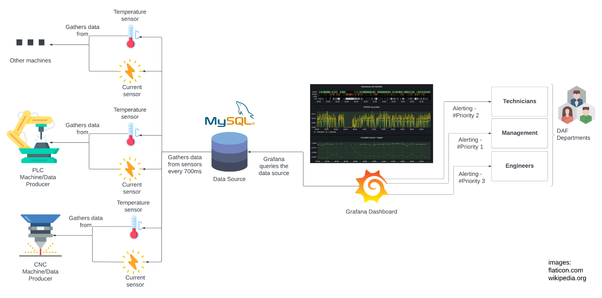

Slide 9
What is next?
Finalize project plan
Grafana research and proof of concept
Another meeting with stakeholders
SCRUM Sprints Setup
Gain new question for the stakeholders

Slide 10
Thank you for your time!

